Slide 1
Windows PE & PXE Deployment in AD DS
Deploying Windows 10/11 via PXE from a Microsoft Deployment Server in an Active Directory Domain System.
This presentation, and more, can be found on my GitHub:
https://github.com/kylekoch012186
PXE Deployment Lab

Slide 2
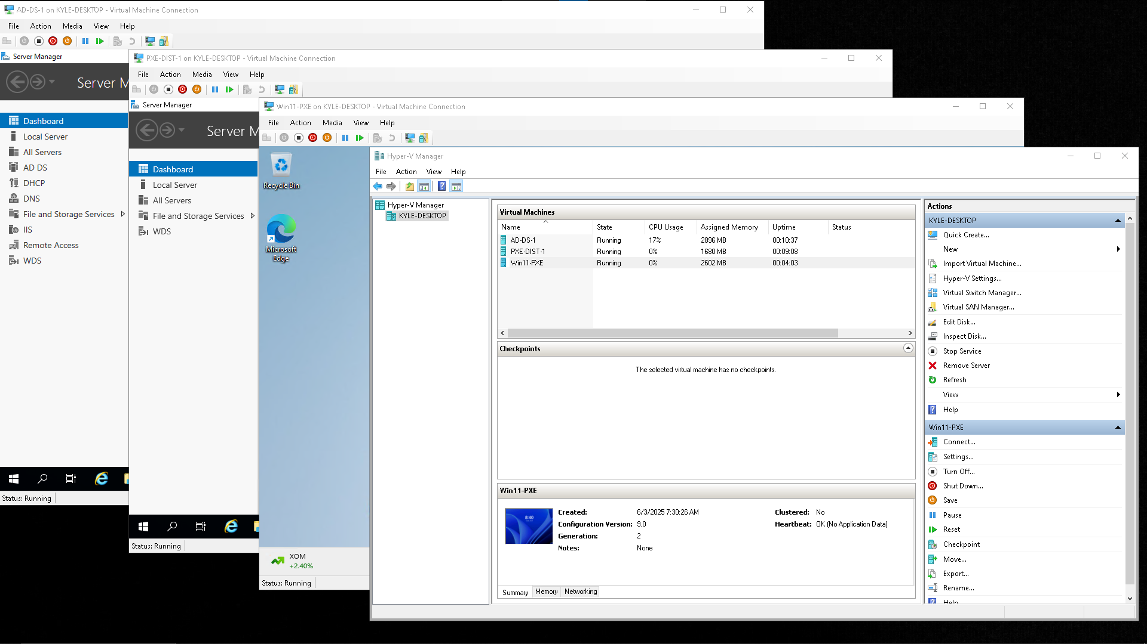
What was the purpose?
This is a lab exercise that achieved the following:
Install Windows Server 2019 for Active Directory (VM1)
Install Windows Server 2019 for PXE Deployment (VM2)
Windows 11 deployment (VM3)

Slide 4
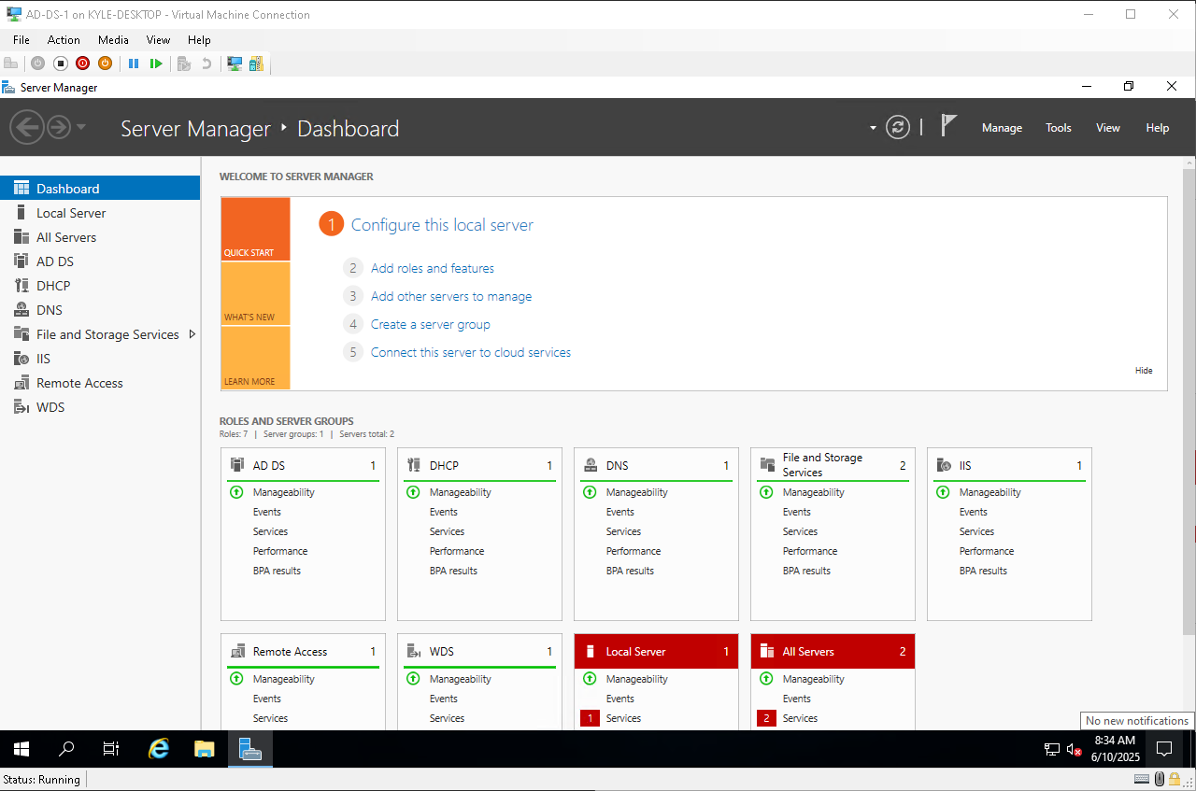
How did I achieve this?
Using Microsoft’s Hyper-V to setup, configure and deploy 3 different virtual machines and have them all running in their own virtualized domain network.
The first VM is setup with Windows Server 2019 and configured with Active Directory in Domain Service mode.
Additionally this server was also configured to host DHCP, DNS, IIS and Routing

Slide 6
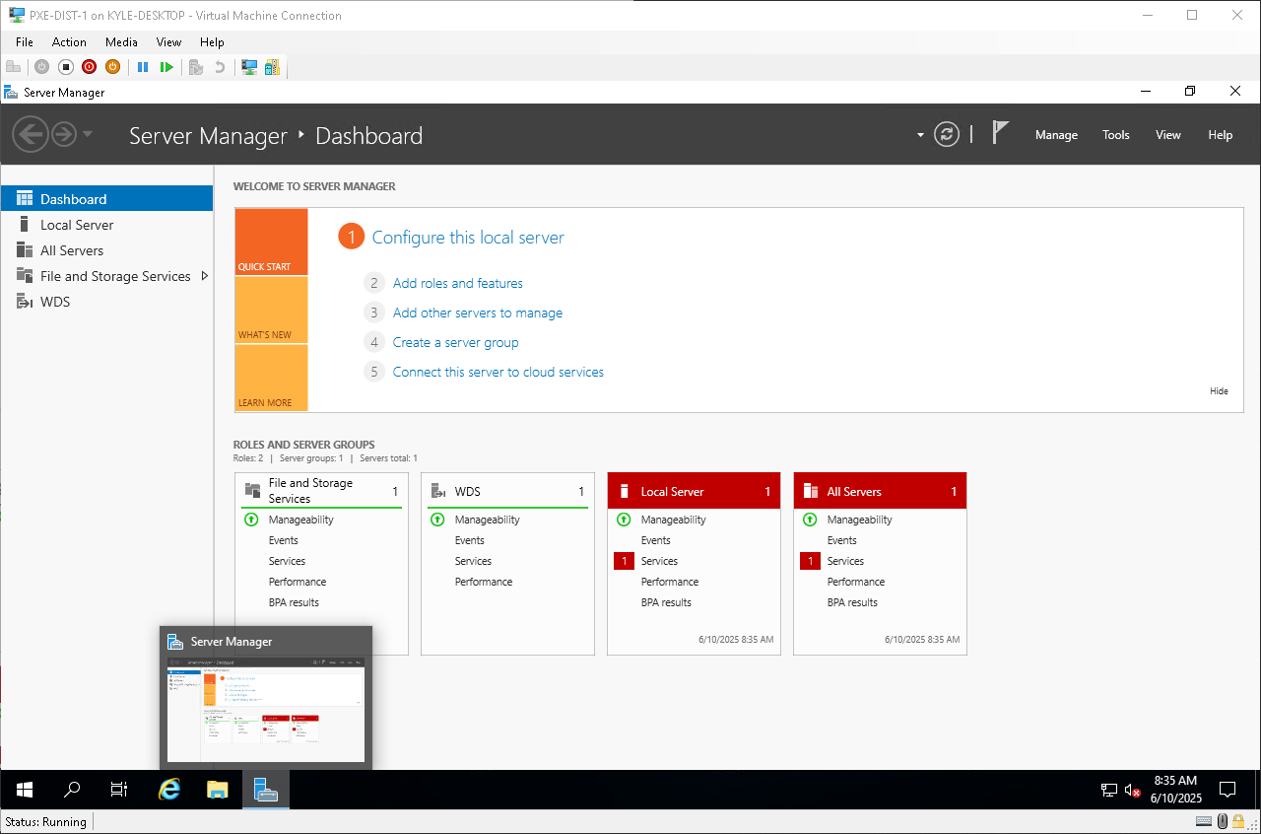
Why ?
As I continue to educate myself, I needed a way to put in to practice the knowledge I gained. This gave me excellent hands on experience with Operating systems and tools that are commonly used around the world from small businesses to large corporations alike. There are many other technologies I have yet to learn. This lab serves as a foundation for me to learn new technologies and software.

Slide 8
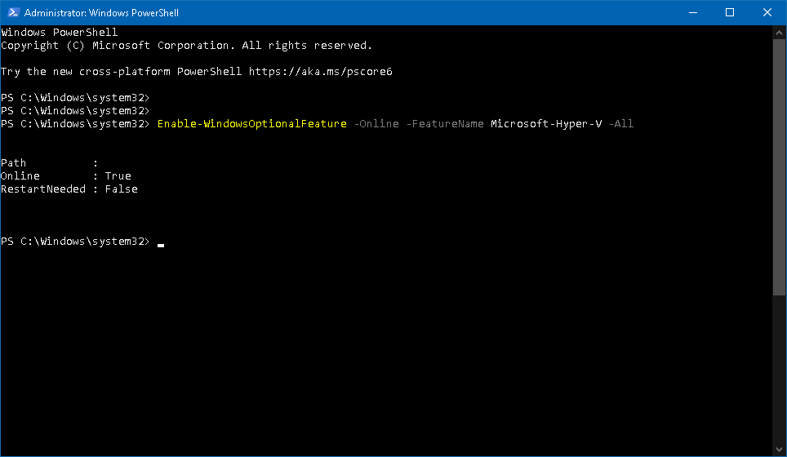
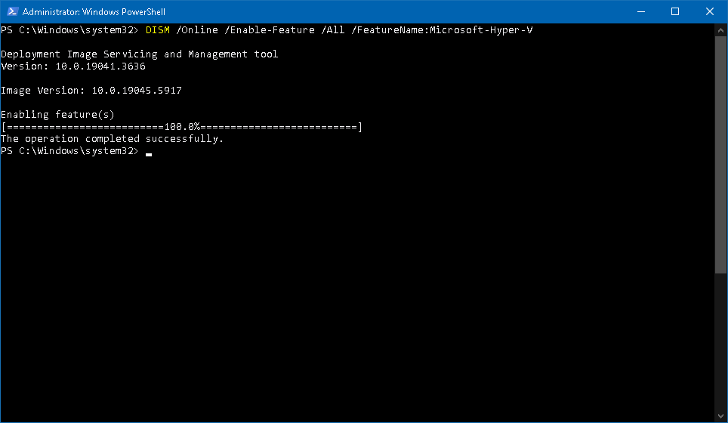
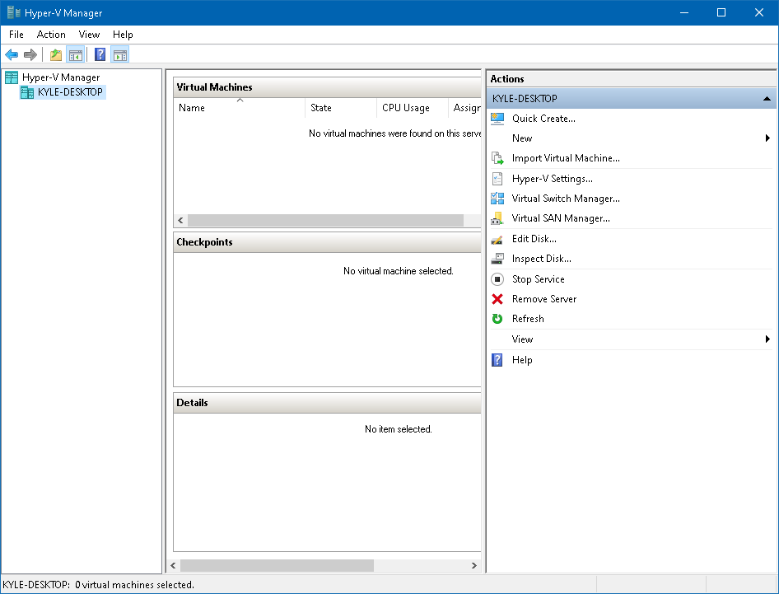
Section 1 - Installing Hyper-V using PowerShell
1
2
3

Slide 9
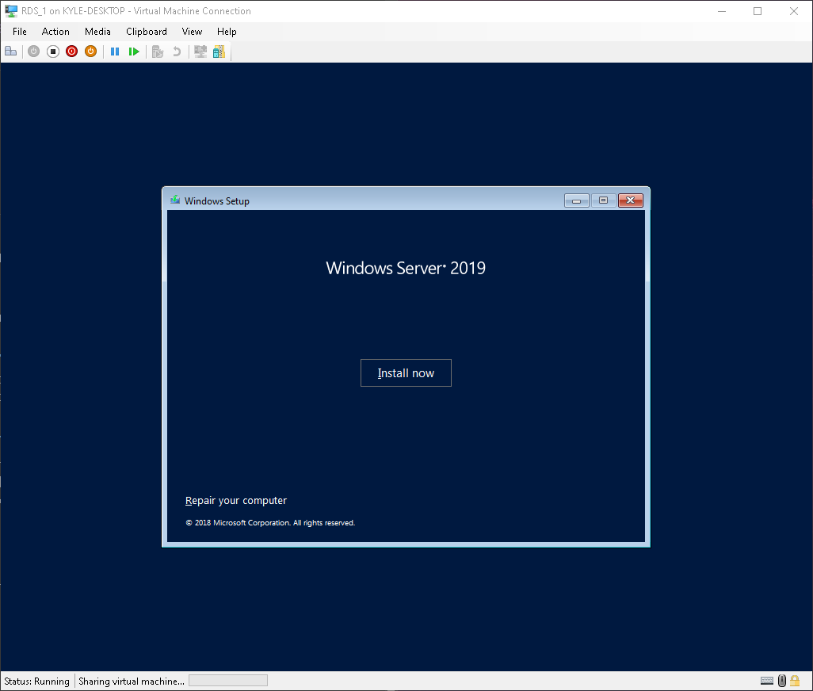
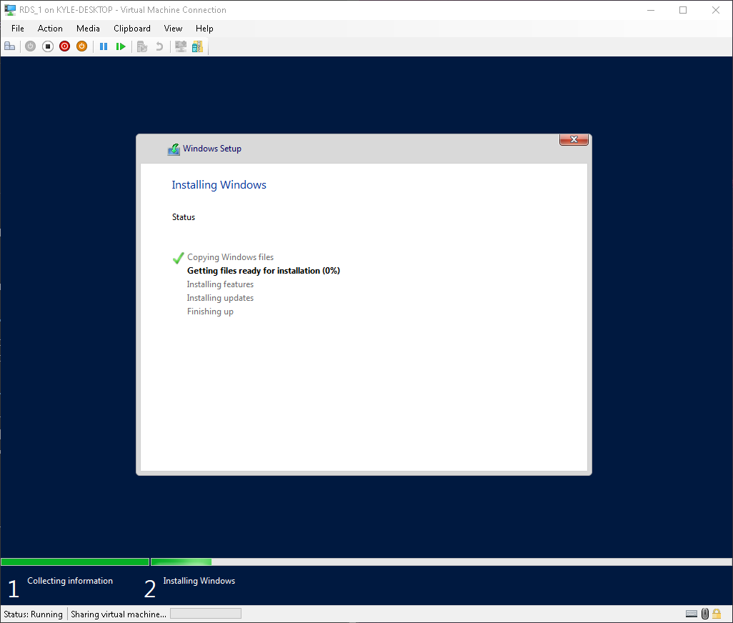
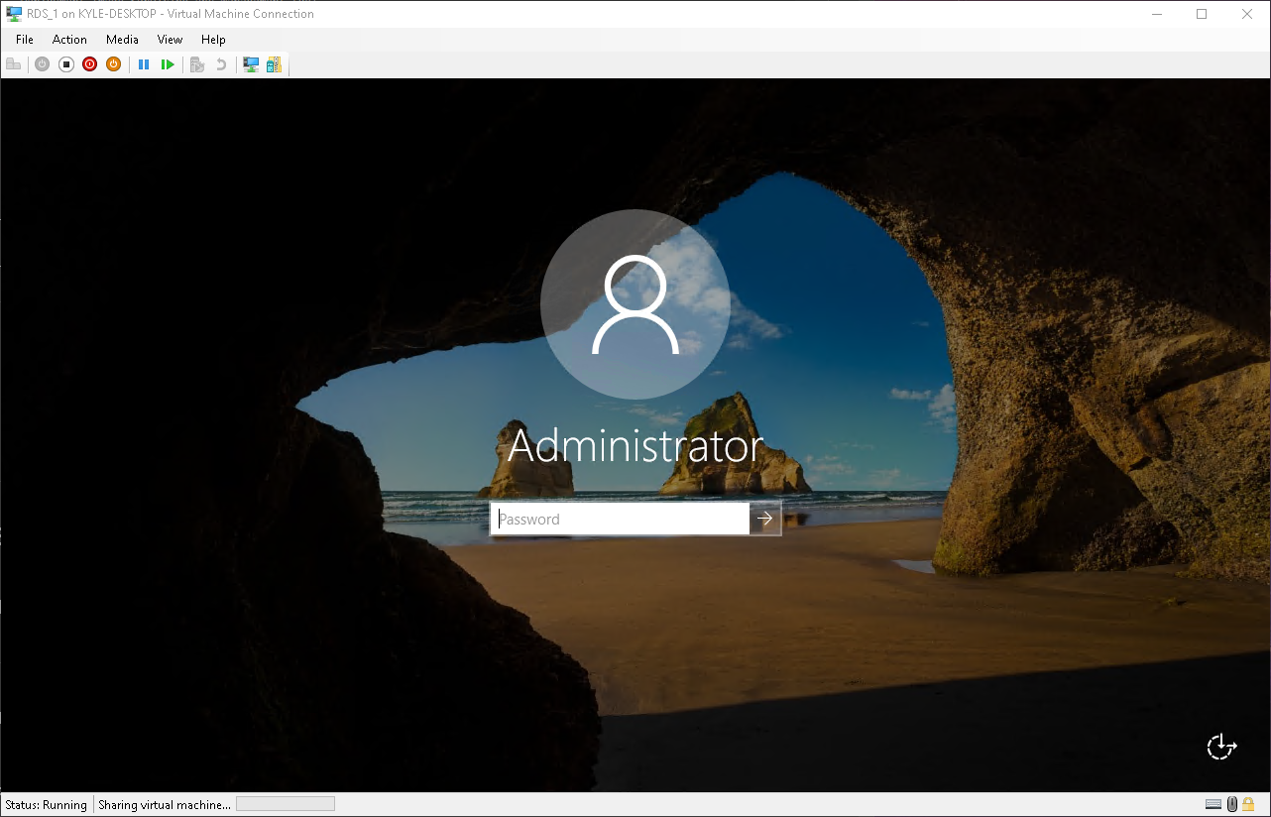
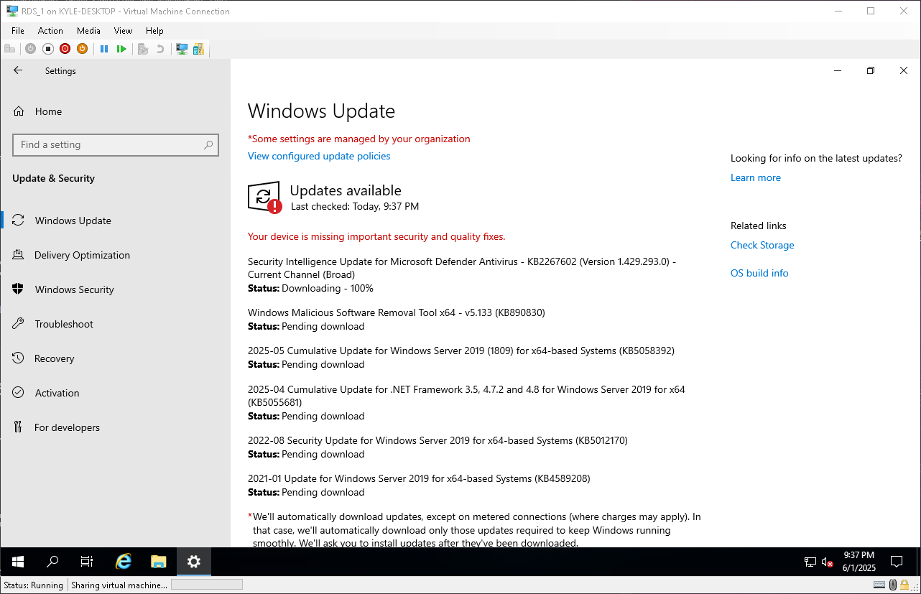
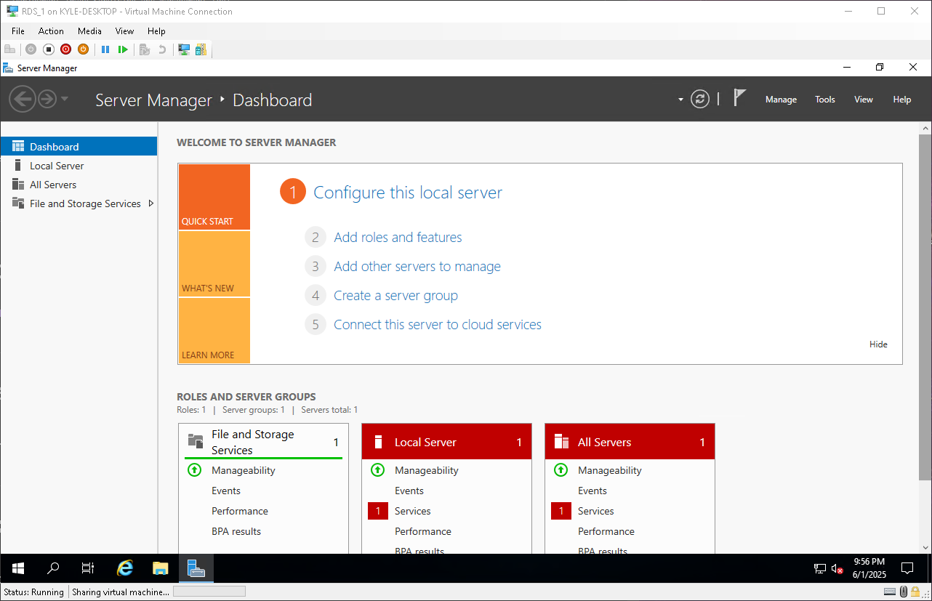
Section 2 - Installing Windows Server 2019 (Evaluation)
2
1
3
4
5

Slide 10
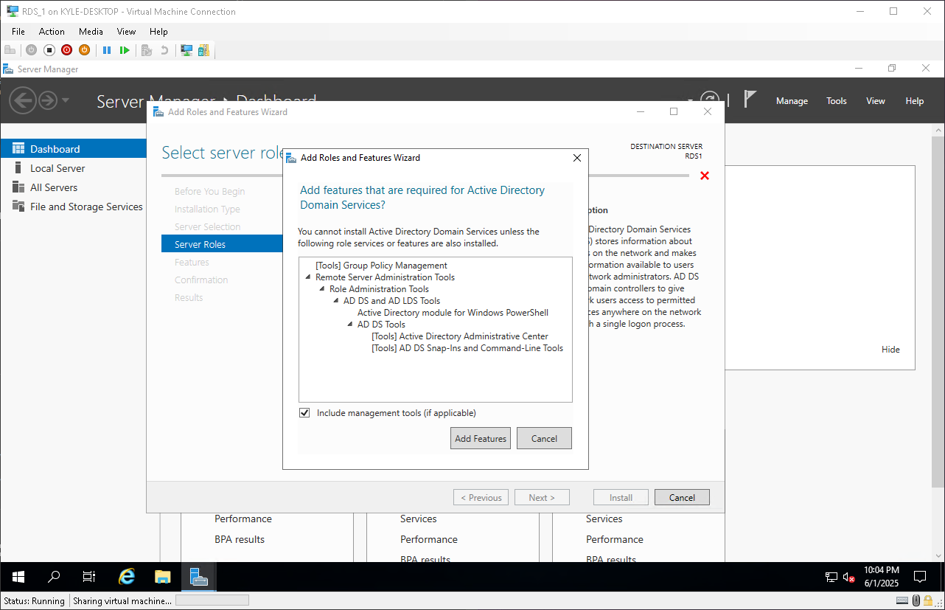
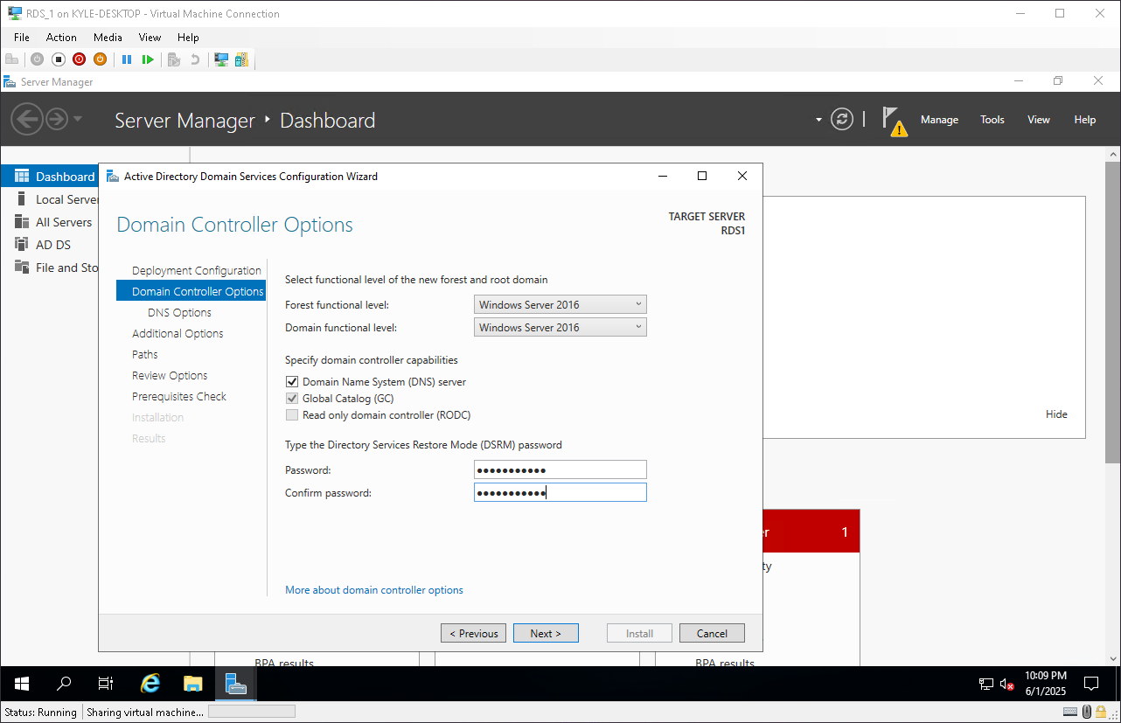
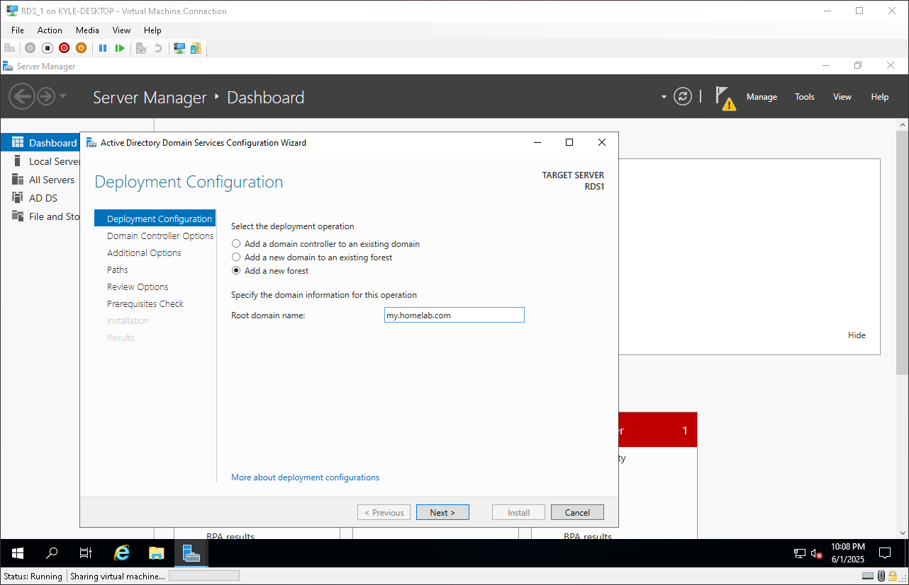
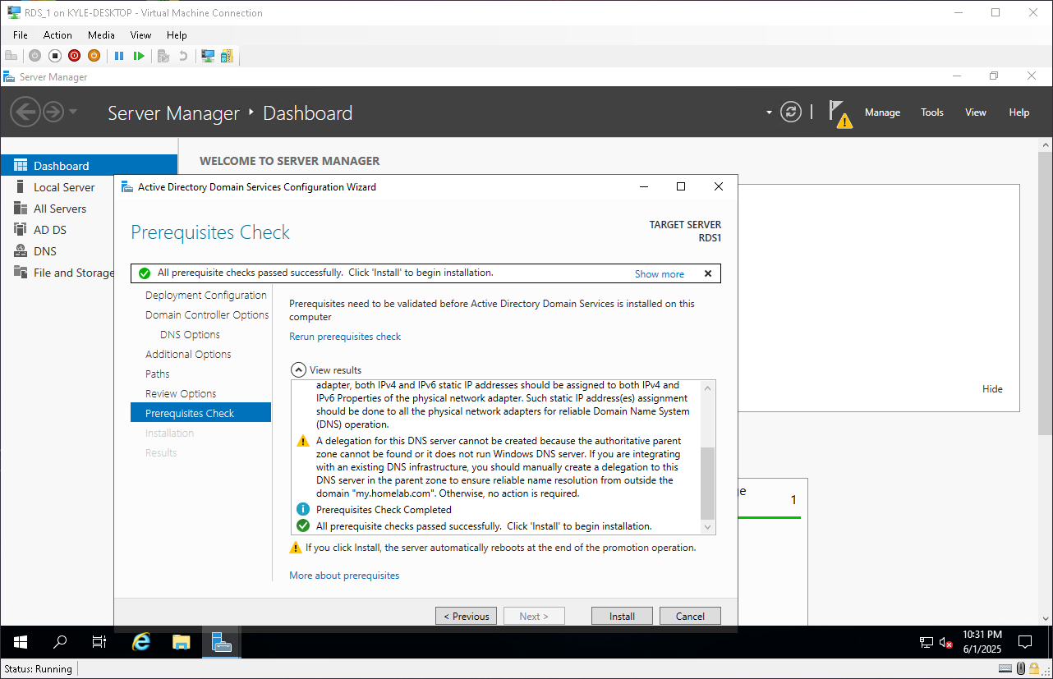
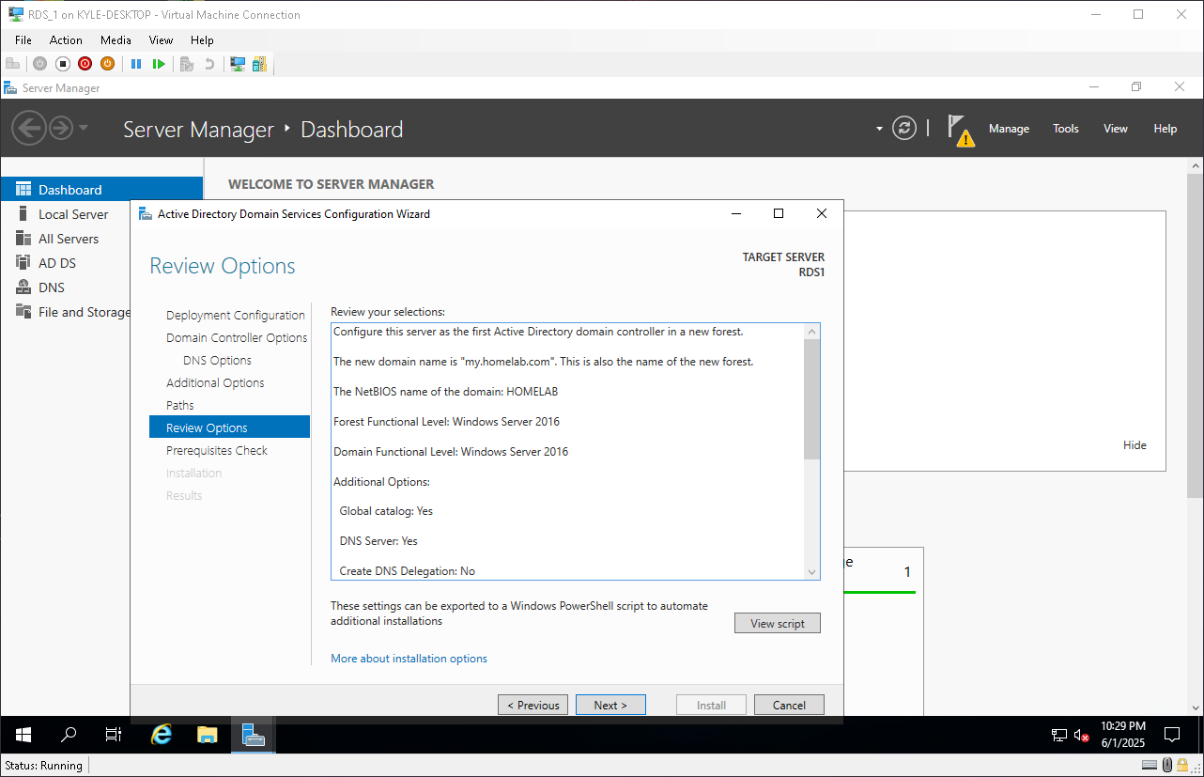
Section 3 - Configuring Active Directory, Domain Services, DNS, and Routing
3
1
2
4
5

Slide 11
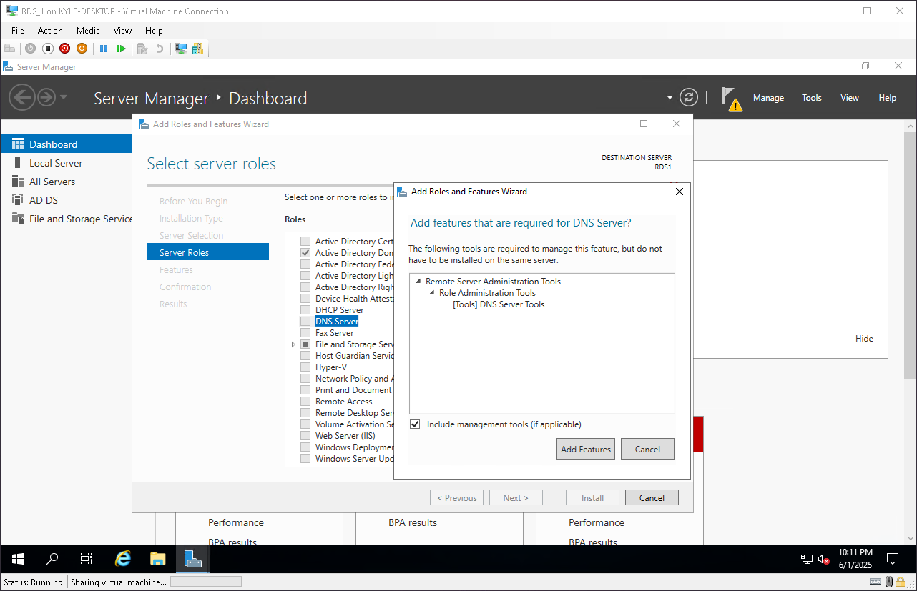
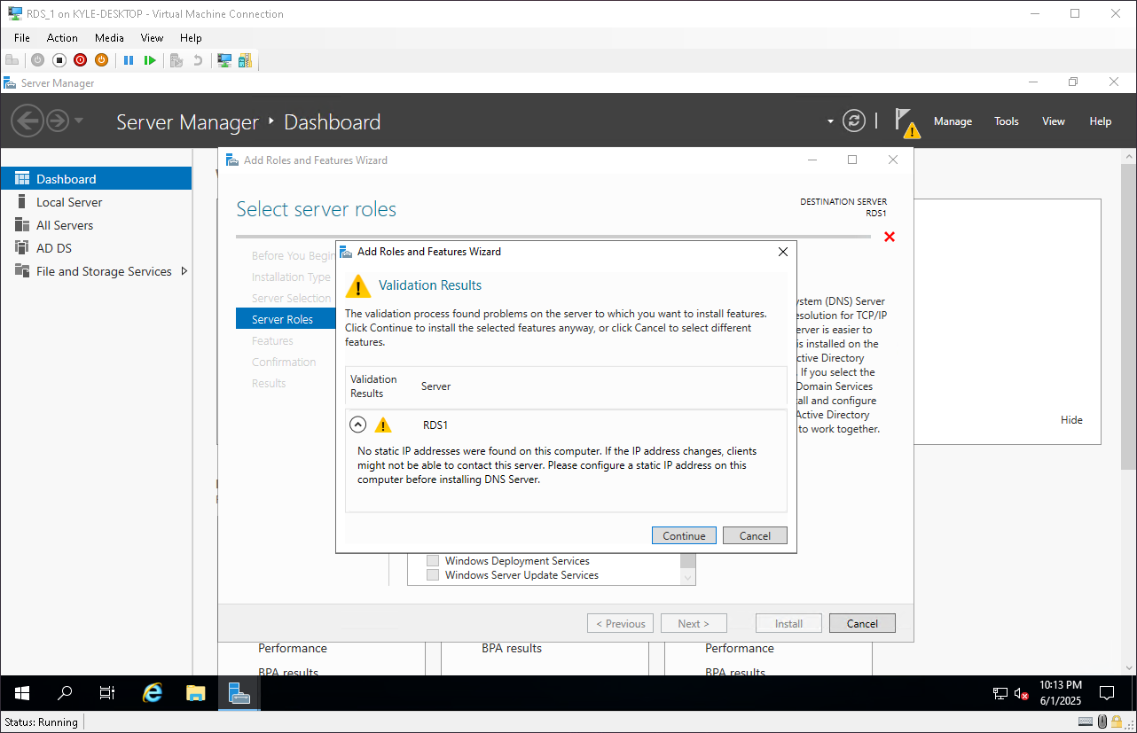
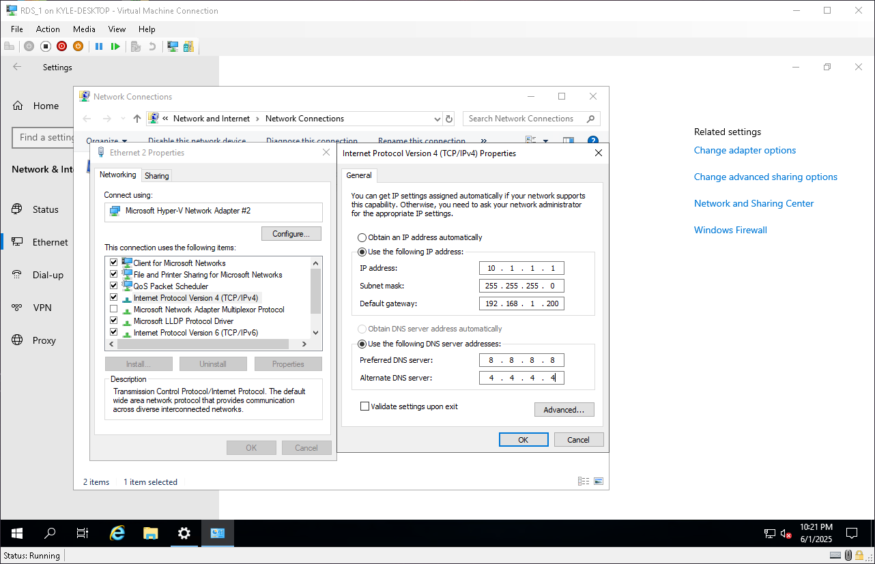
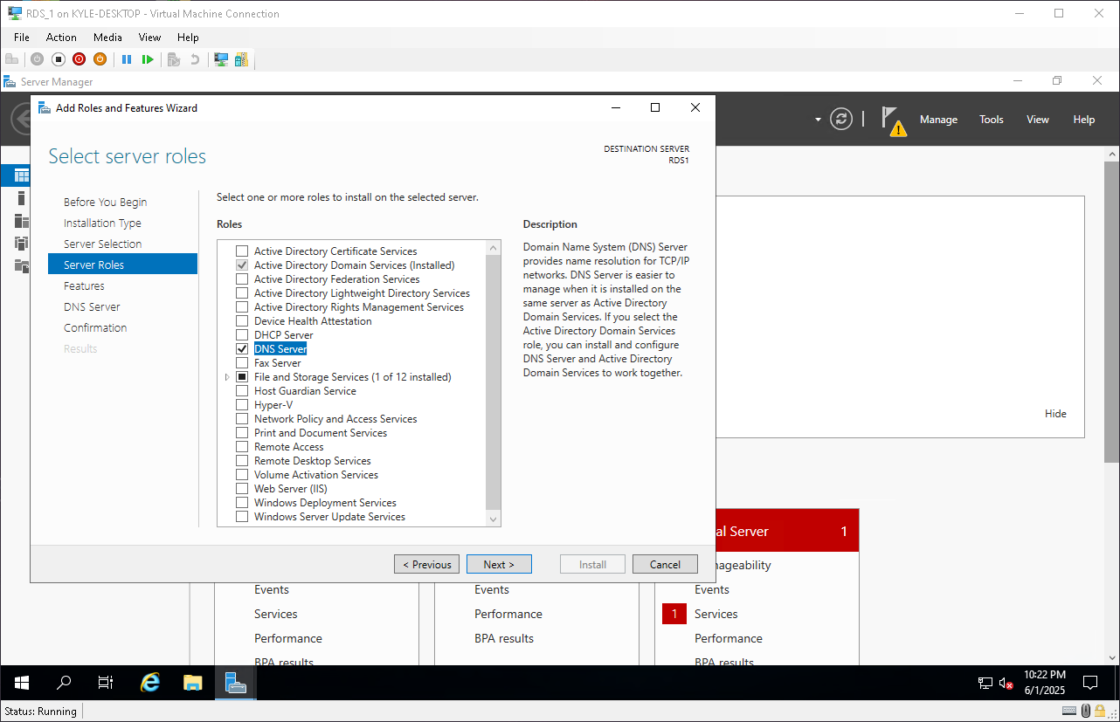
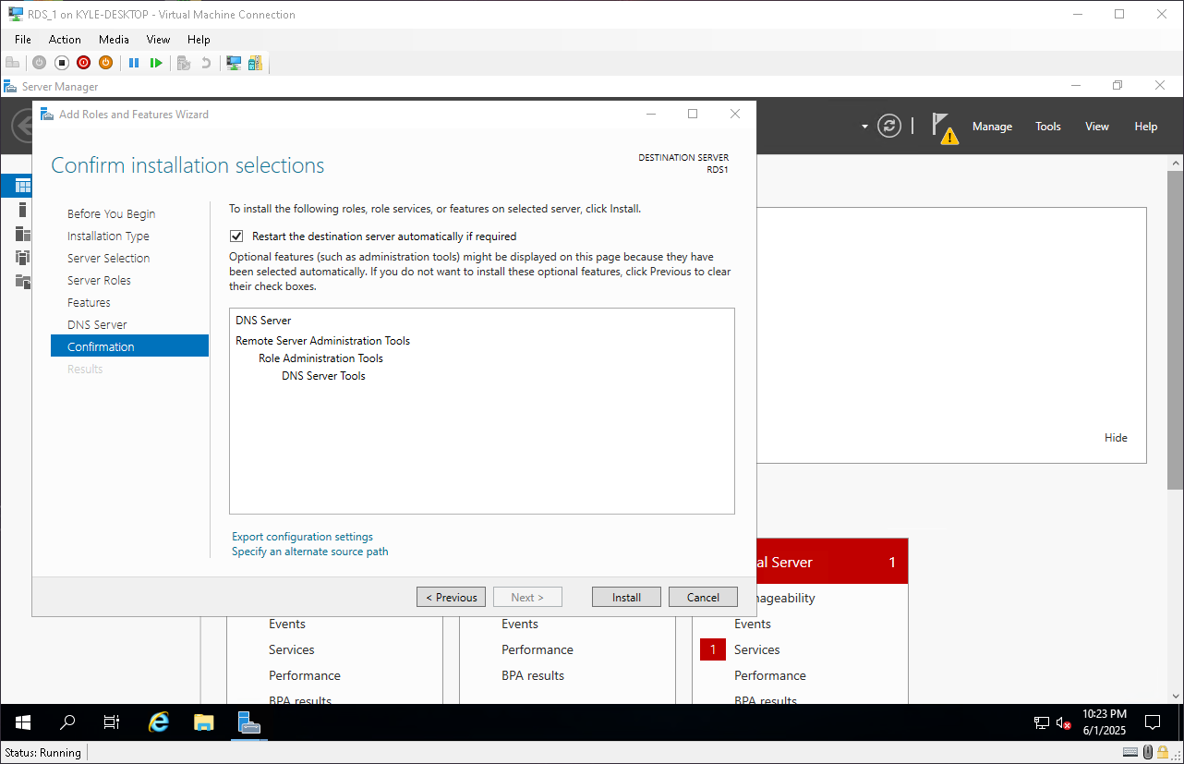
Section 4 : Setting up DNS
2
1
3
5
4

Slide 12
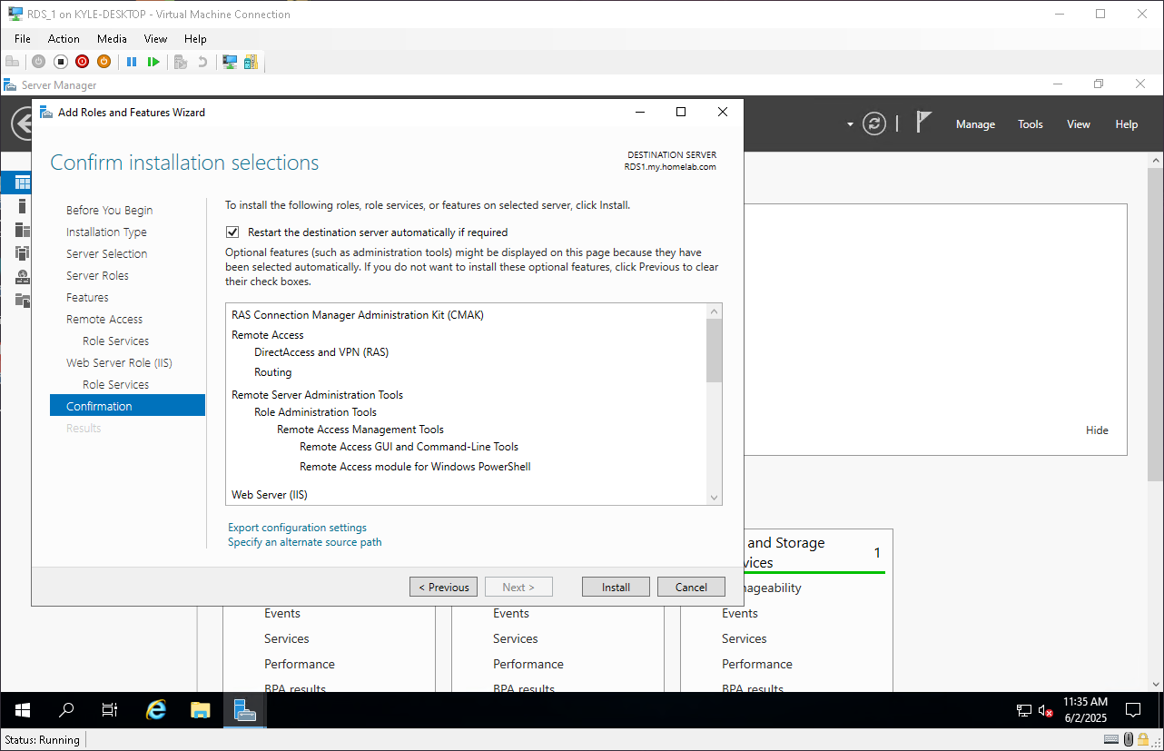
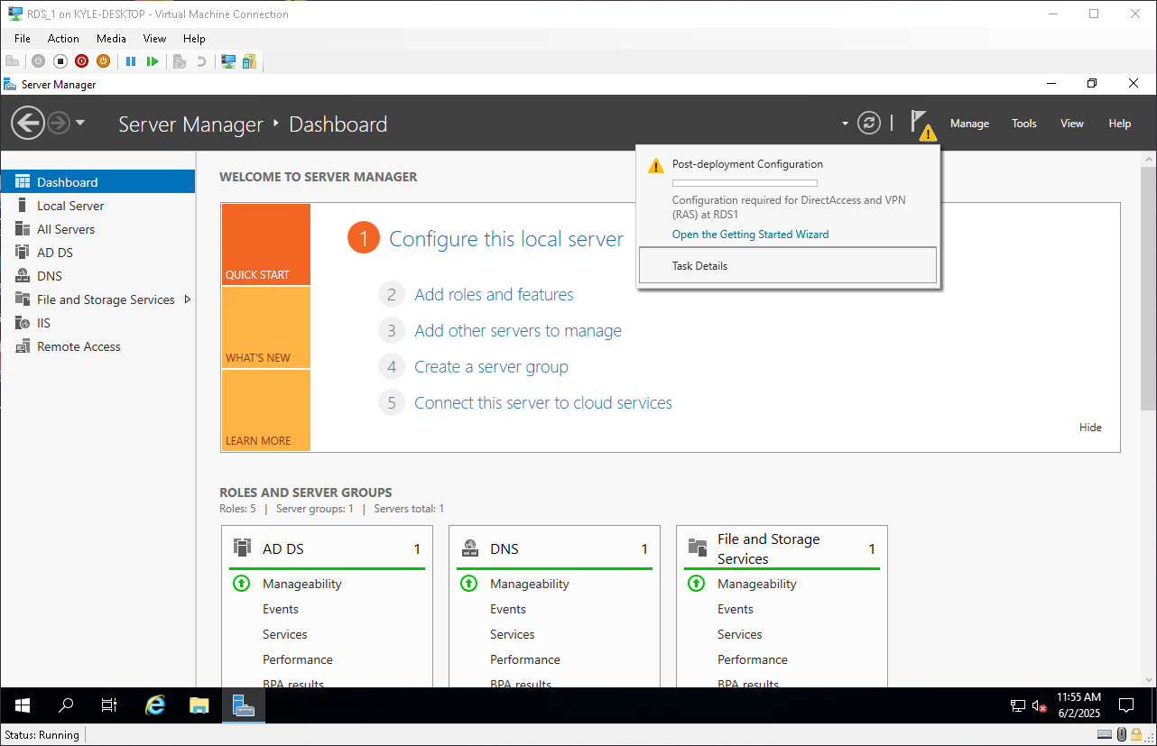
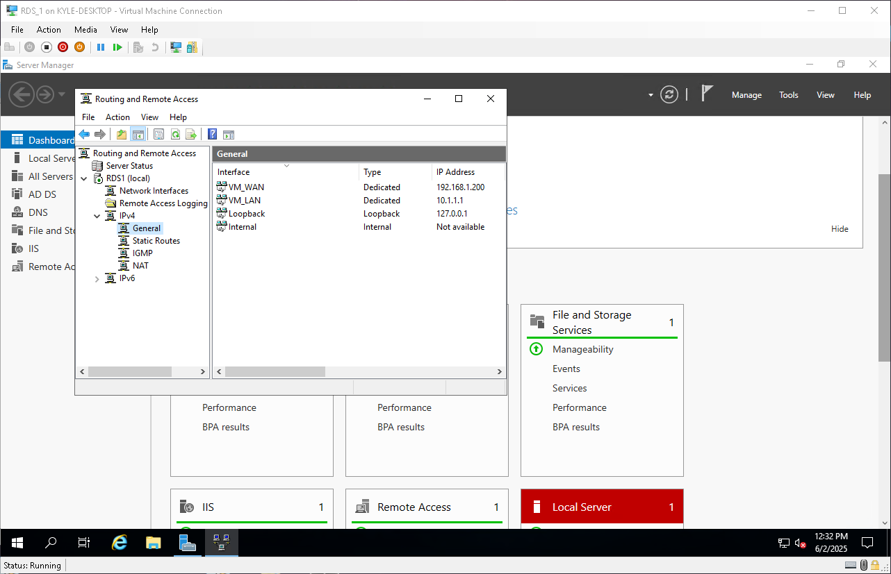
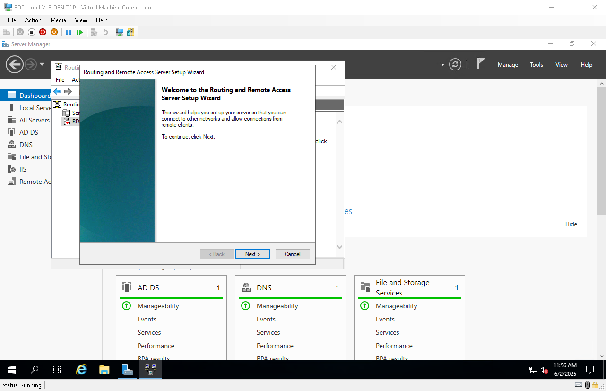
Section 5 : Setting up Windows Routing

Slide 13
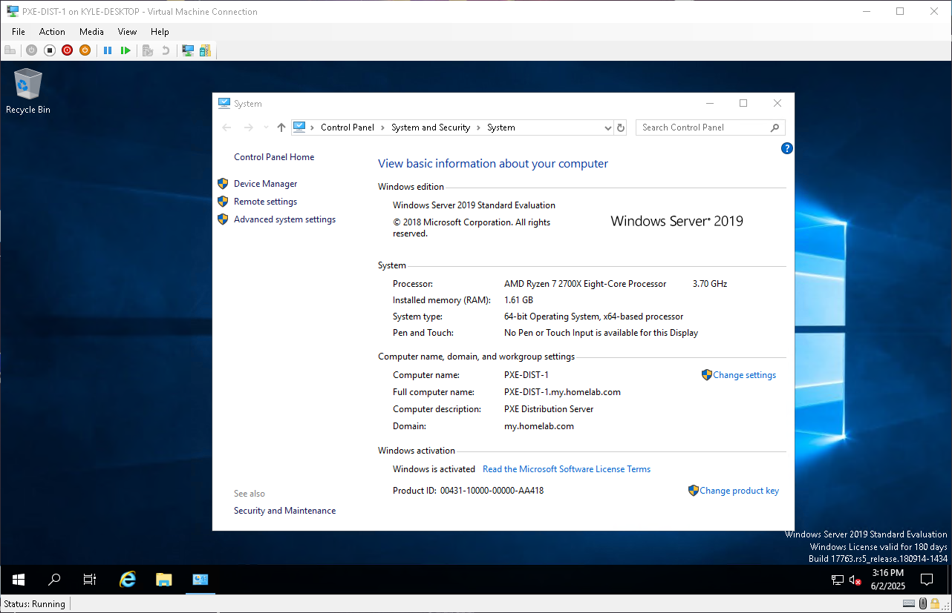
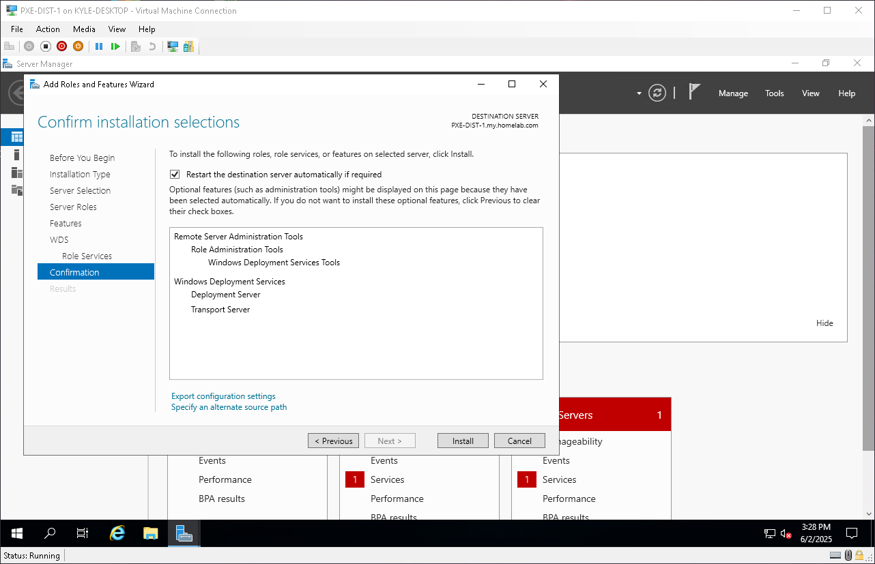
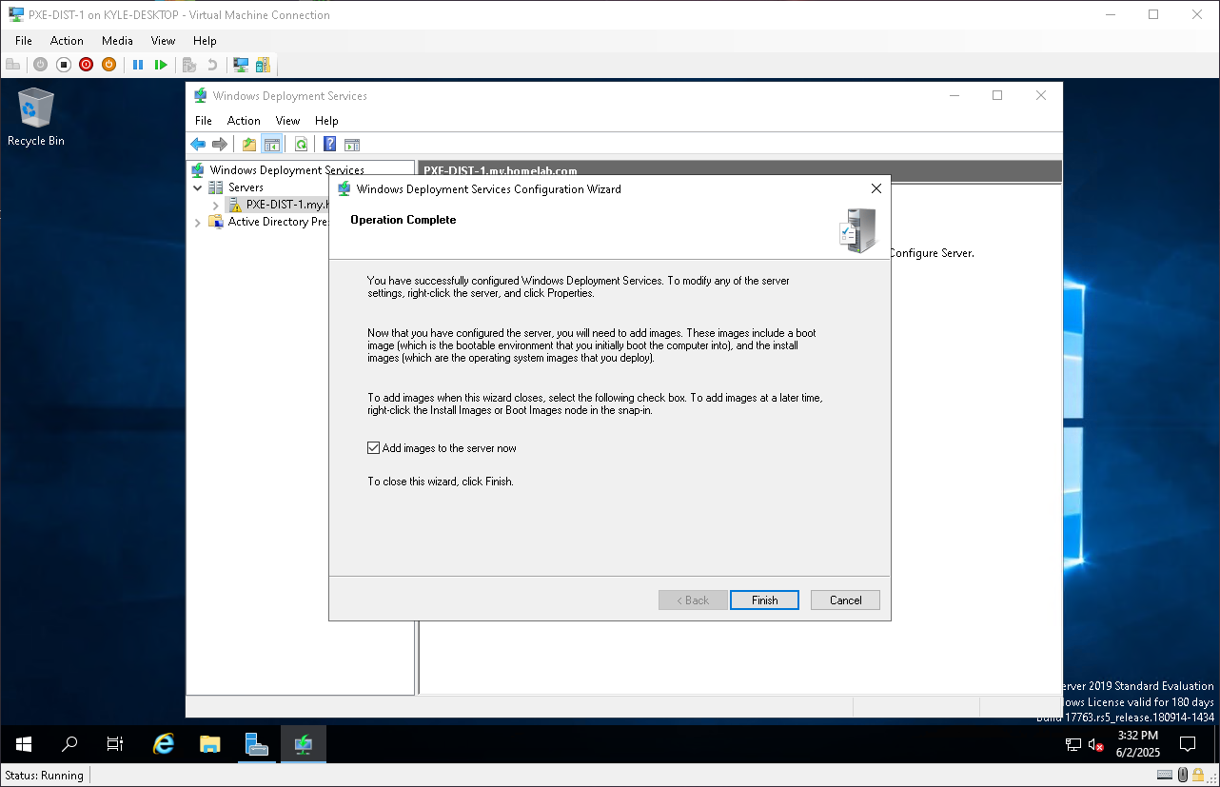
Section 6a : Installing Windows Deployment Service
Setup of VM2 and Windows server install done in background as its the same as the Domain Server from Section 1
Top left: Confirming VM2 windows configuration
Top Right: Installing Windows Deployment Service
Install Complete

Slide 14
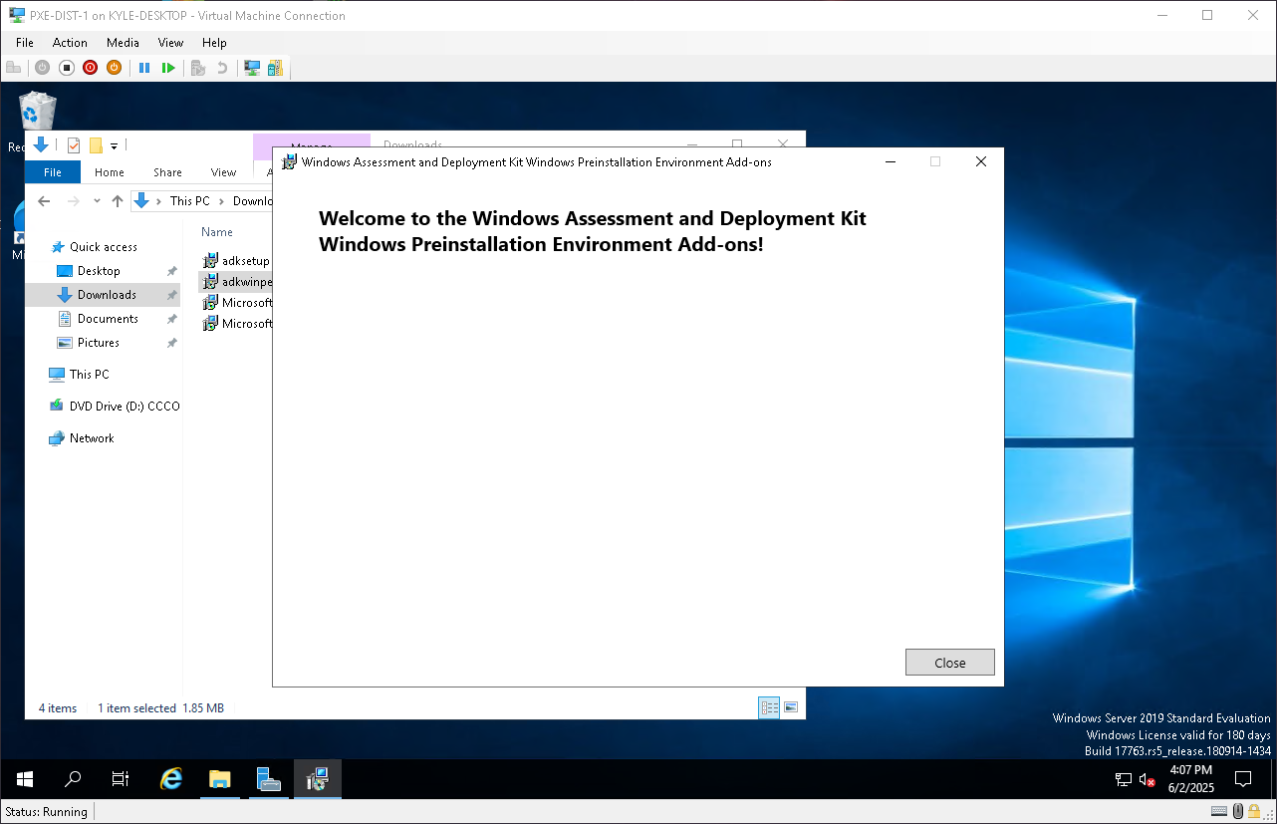
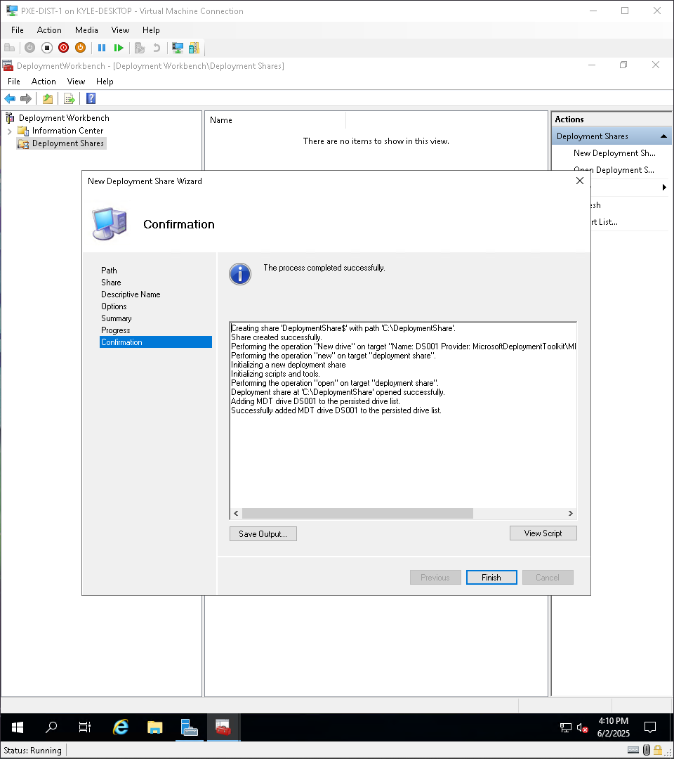
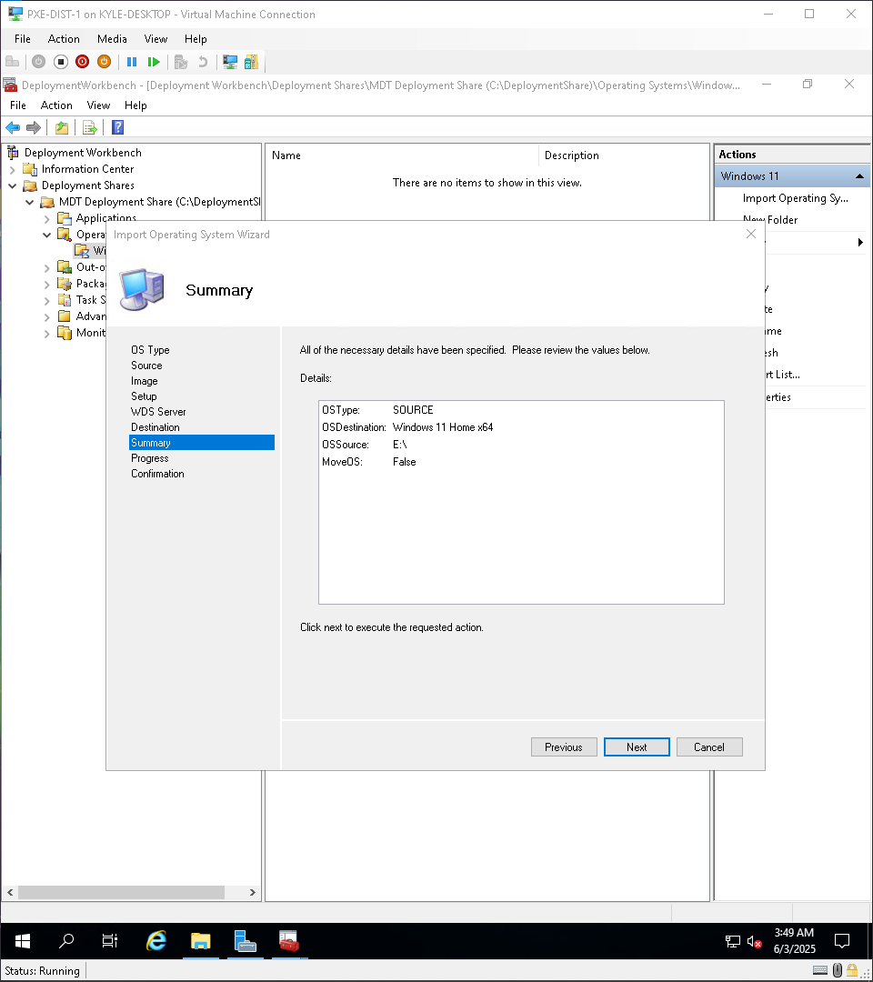
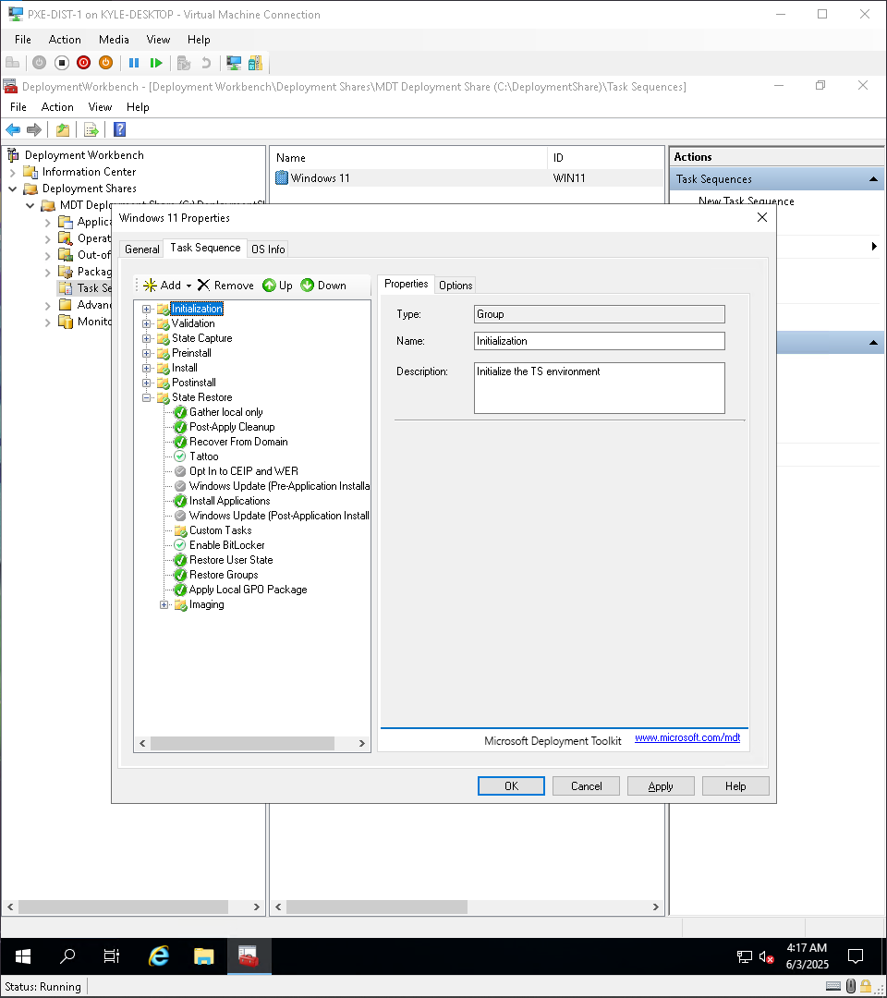
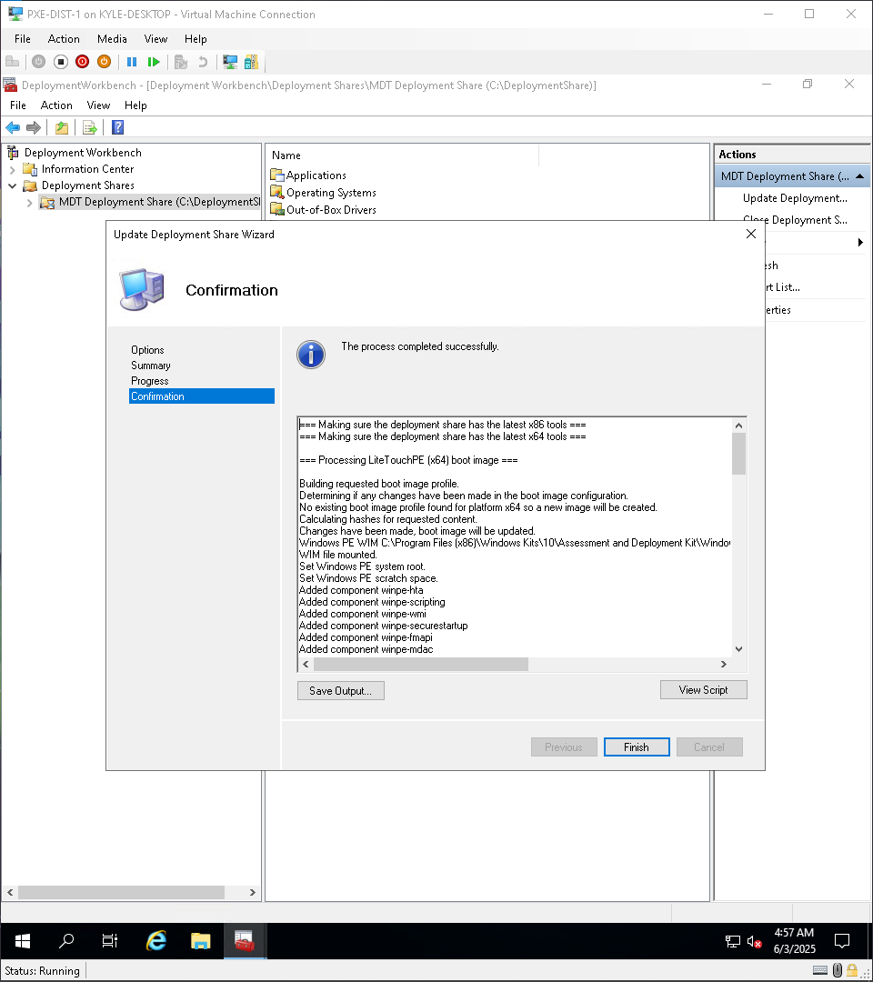
Section 6b : Installing Deployment Workbench and creating the share

Slide 15
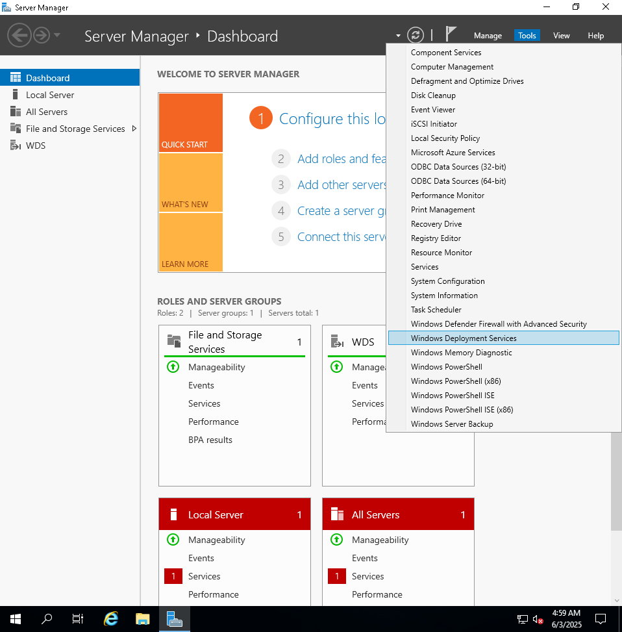
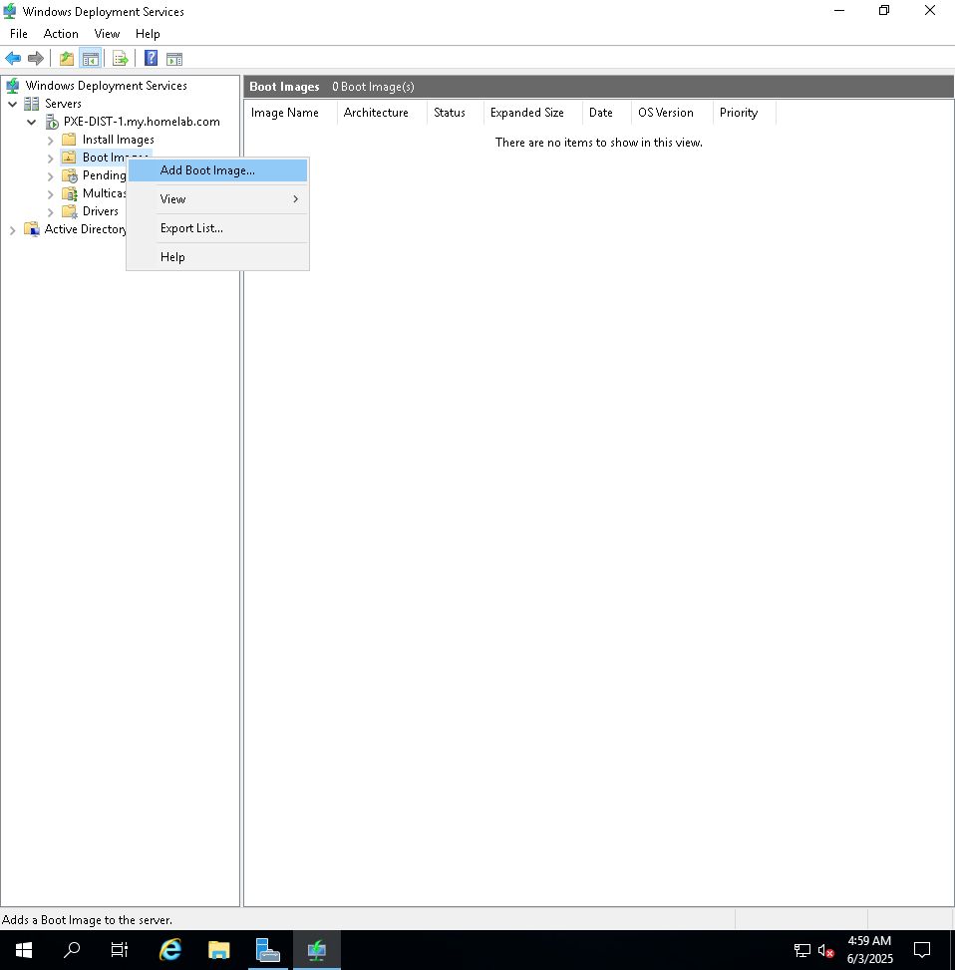
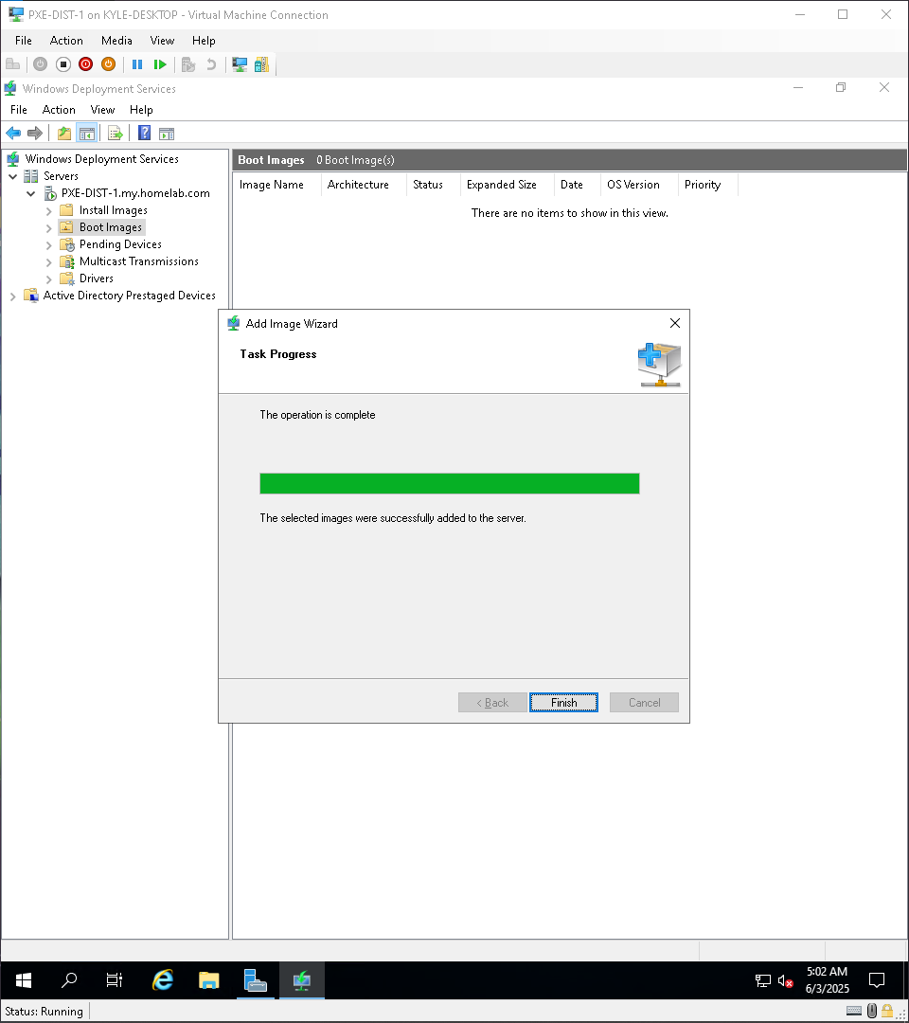
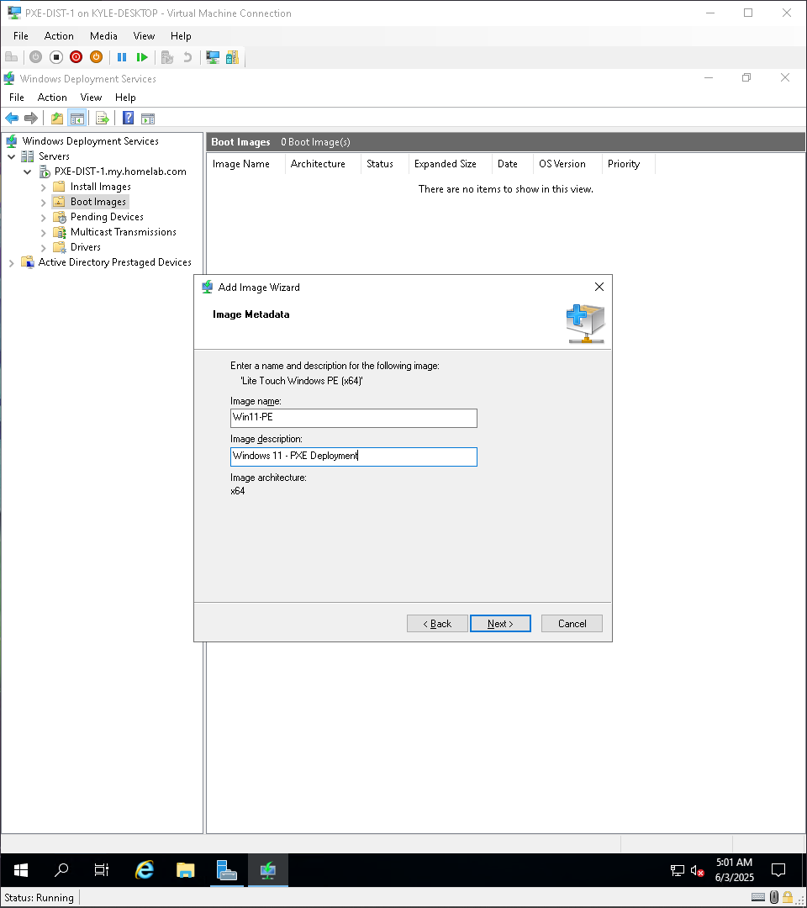
Section 6c : Creating the Deployment Share

Slide 16
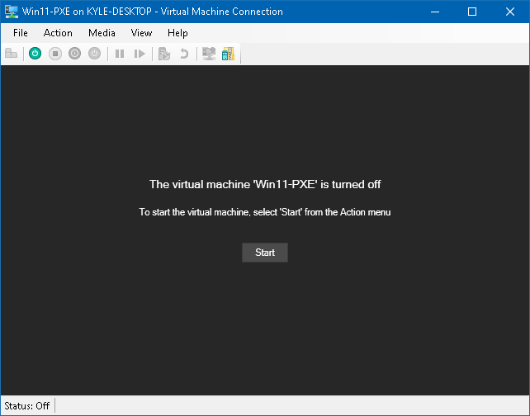
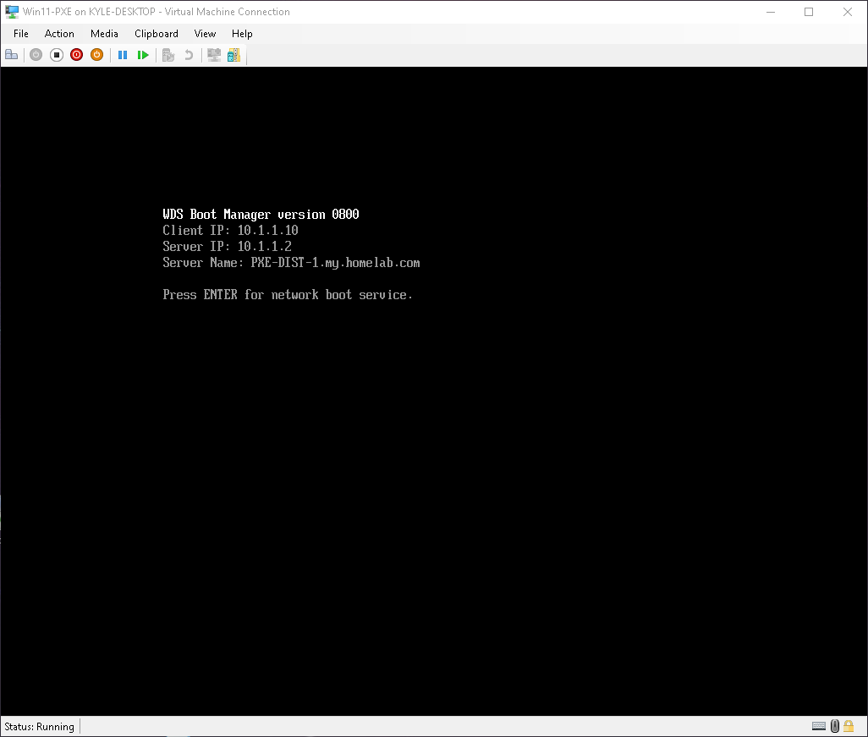
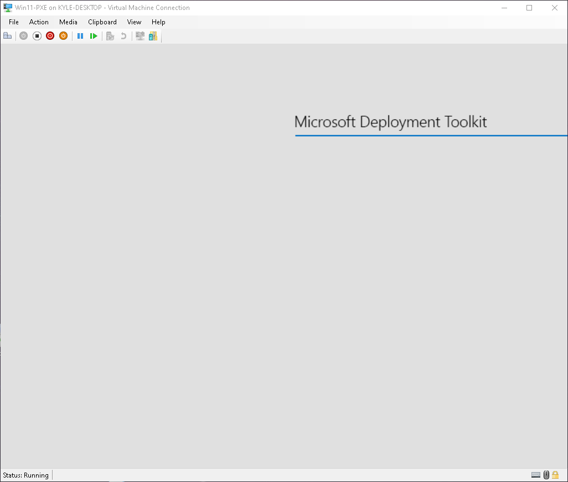
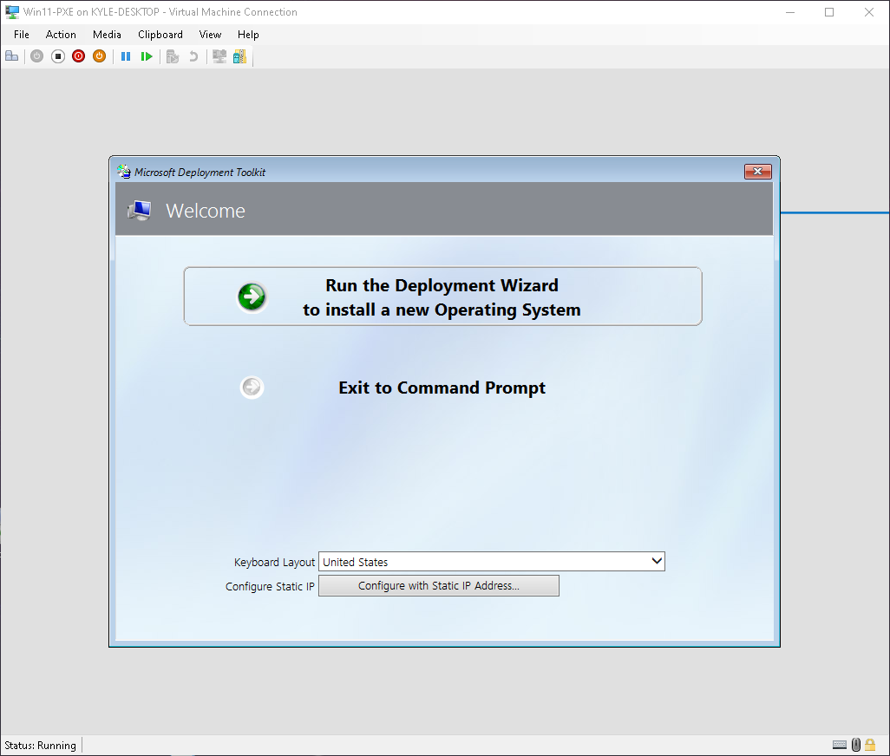
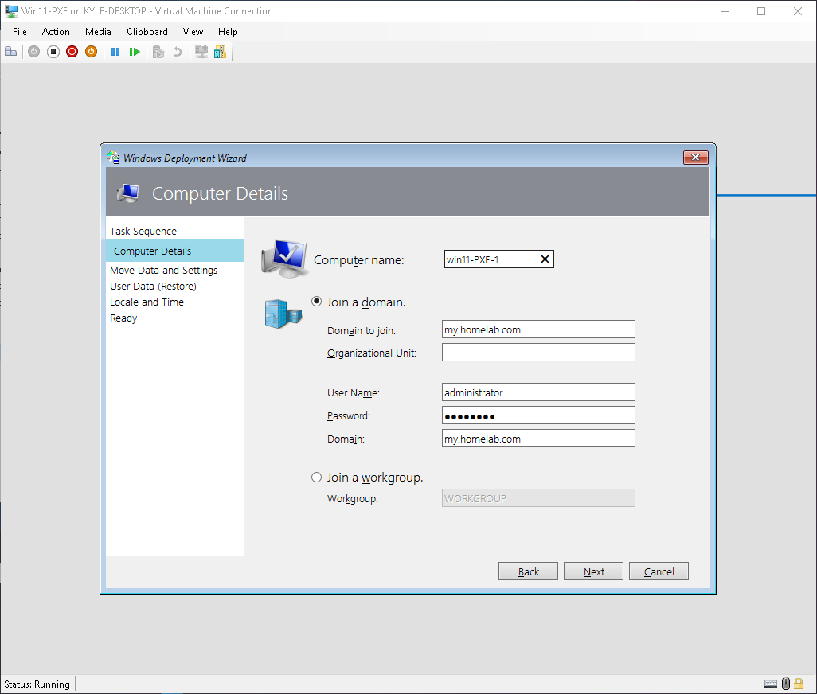
Section 7 : Deploying Windows 11 via PXE

Slide 17
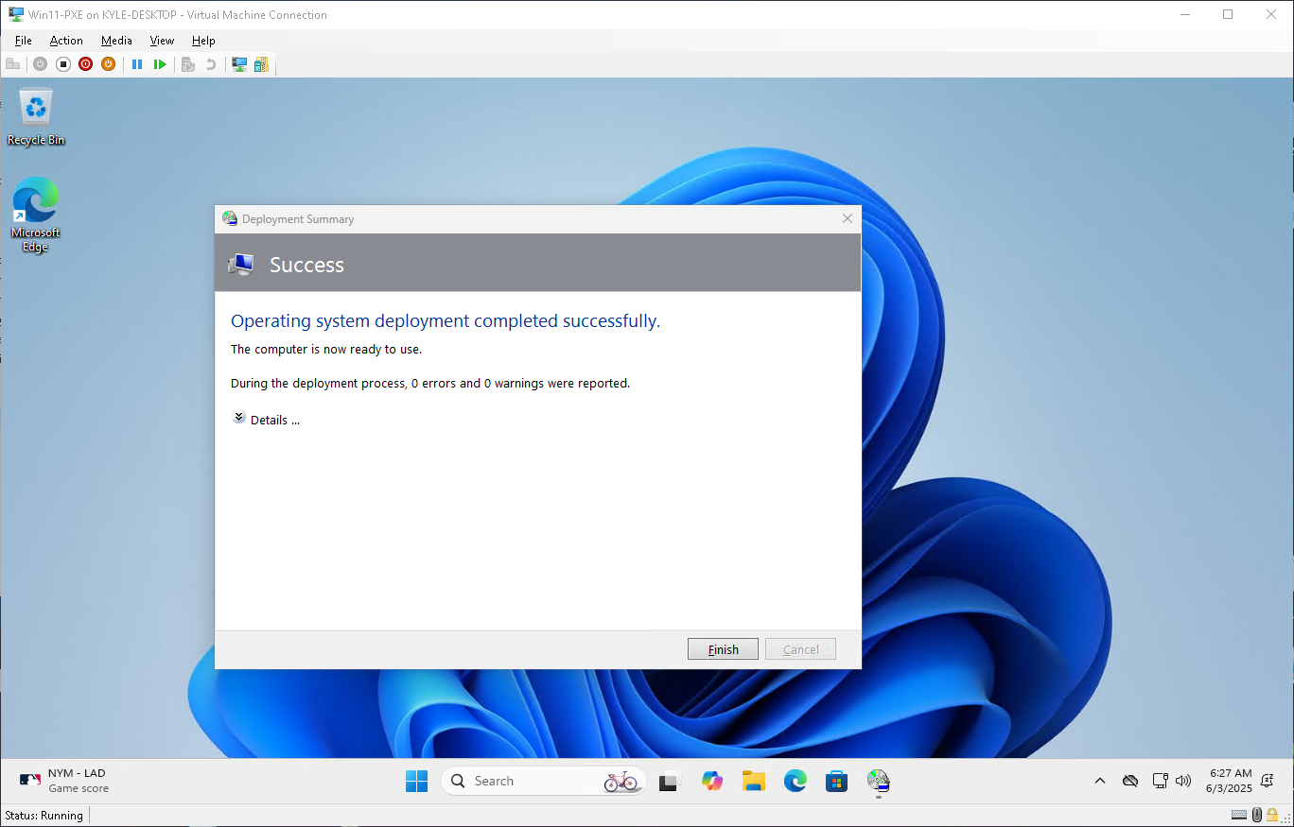
Finale : Network Deployment Successful!

Slide 18
Close Out
This lab was fun to complete. There were a few bumps in the road but with research and persistence I was able to find a resolution. This slide show merely shows a snippet of the resources I put together. The full set of screenshots, for this lab, are available on my GitHub page linked below. In the repository, each of the screenshots are broken down by section. Each section coincides with the sections outlined by this power-point. There are also simple descriptor files that notate each and every screenshot to make it easy to follow along.
Thank you for taking the time to view this presentation!
Kyle Koch
GitHub : https://github.com/kylekoch012186/PXE_Deployment_Lab

